Slide 1

Action Plan
Time Tracking Program
News
Quotes
COVID Updates
Text To Speech Program
Notification

Slide 2

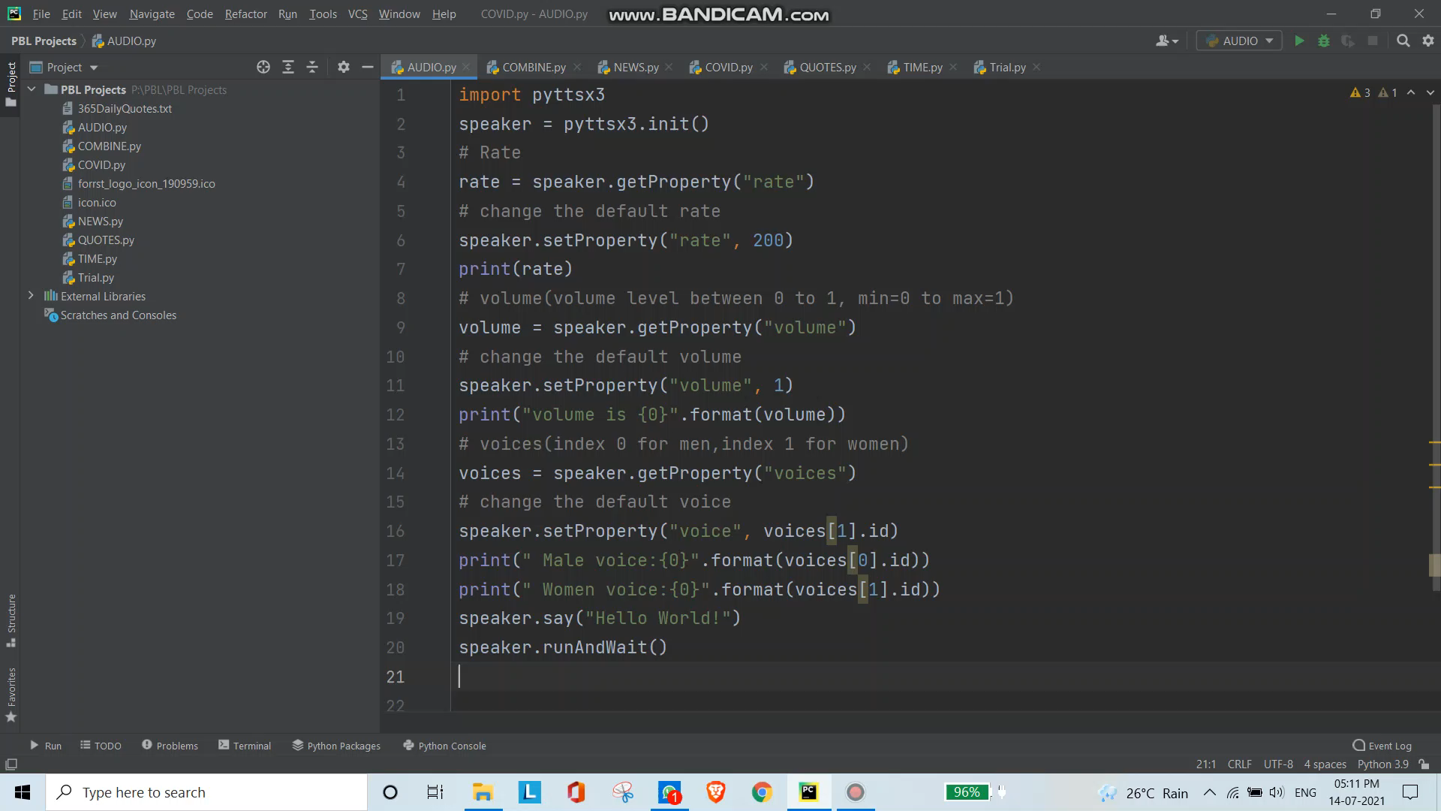
Chapter II : Text To Audio Program Video

Slide 3

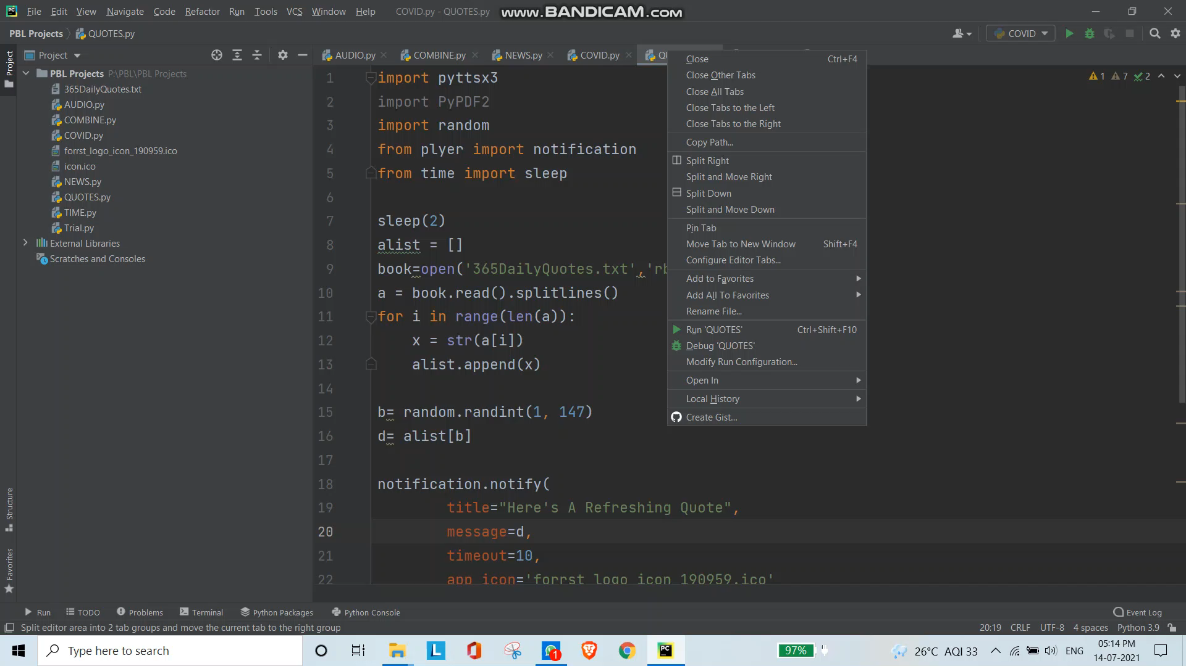
Chapter III : Random Quotes Program Video

Slide 4
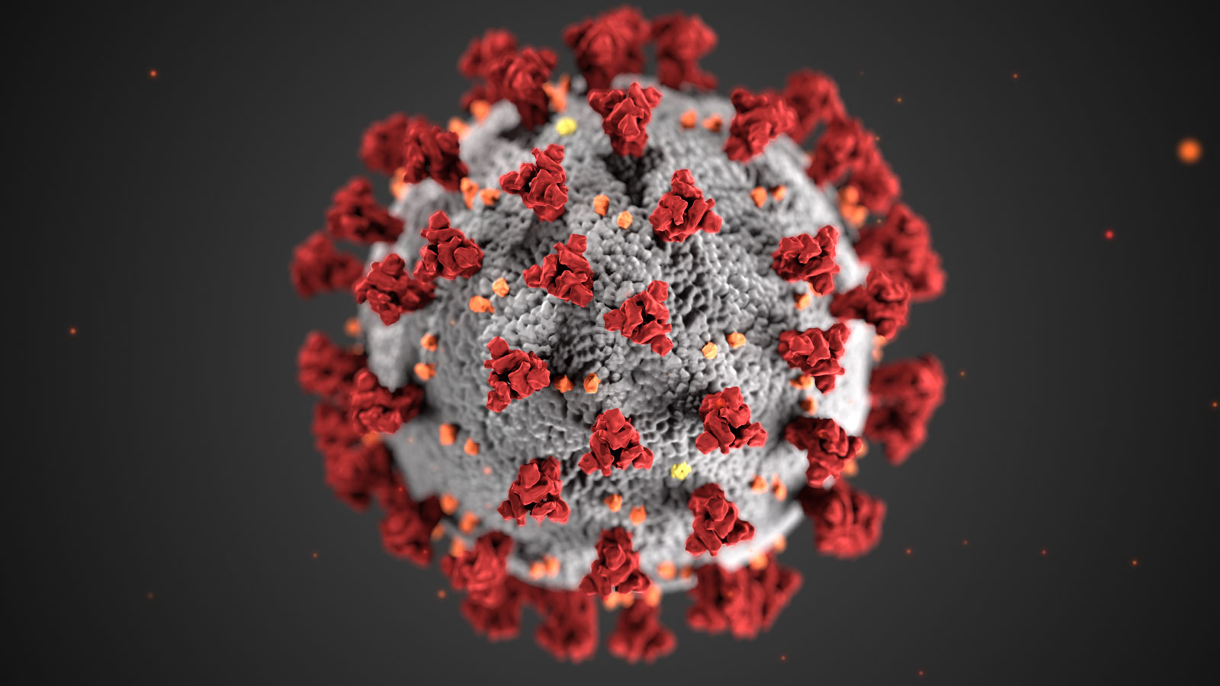
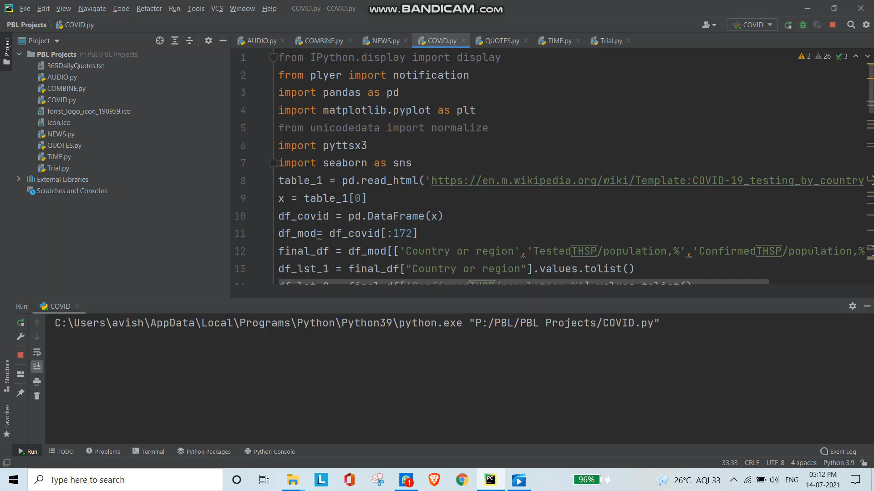
Chapter IV : COVID Data Scraping Program Video

Slide 5

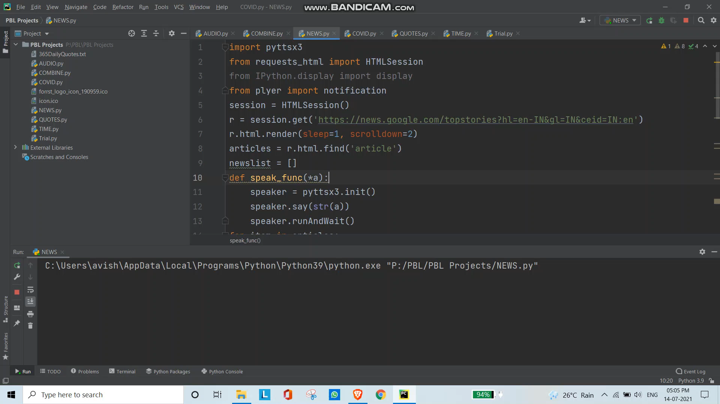
Chapter V : News Notification Program Video

